Slide 1
CPSC 875
John D. McGregor
Scheduling Threads

Slide 2
Real-time scheduling
When there are more threads than processors scheduling becomes necessary.
When there is a certain amount of work that must be done in a certain amount of time it is no longer possible to be certain that the goal can be achieved.
The analyses can be complicated and time consuming.

Slide 3
Cheddar
Download and unzip
http://beru.univ-brest.fr/~singhoff/cheddar/
There is a parser problem. To import an AADL file some properties will have to have the argument changed to a list by adding parenthesis:
The error message on a line like the following:
Cheddar_Properties::Source_Text => "arinc_processor.sc";
Can be resolved by adding parenthesis like this:
Cheddar_Properties::Source_Text => ("arinc_processor.sc");

Slide 4
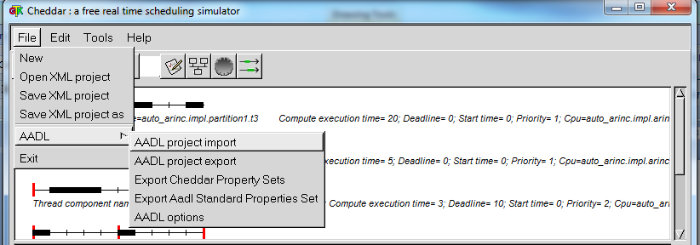
Cheddar - 2
There is a set of Cheddar specific properties that are in the download
The following is an AADL file that has been modified to pass the Cheddar parser

Slide 5
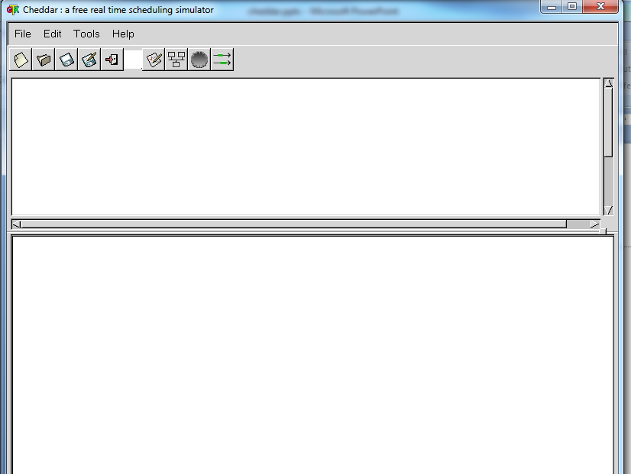
Cheddar GUI
Even after a successful import the GUI will show empty boxes.
Go ahead and select a function such as the scheduling

Slide 6
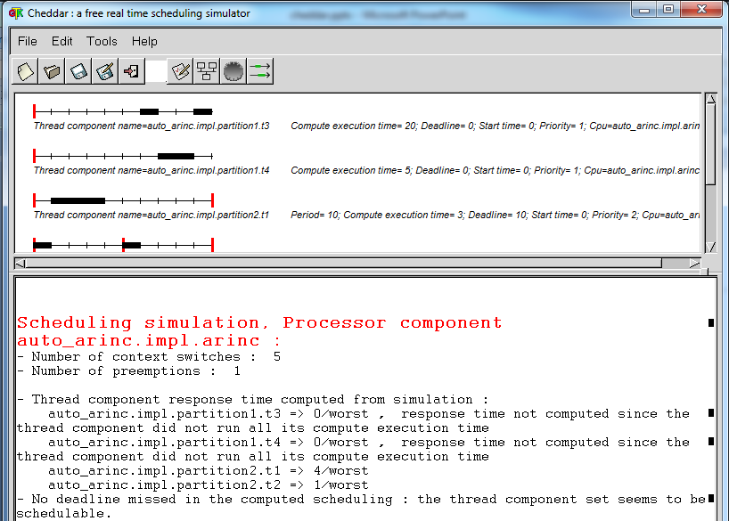
Cheddar GUI

Slide 7
Example model
thread T1
end T1;
thread implementation T1.Impl
properties
Dispatch_Protocol => Periodic;
Compute_Execution_Time => 3 ms .. 3 ms;
Cheddar_Properties::Dispatch_Absolute_Time => 0 ms ;
Cheddar_Properties::POSIX_Scheduling_Policy => SCHED_FIFO;
Cheddar_Properties::Fixed_Priority => 2;
Deadline => 10 ms ;
Period => 10 ms ;
end T1.Impl;
thread T2
end T2;
thread implementation T2.Impl
properties
Dispatch_Protocol => Periodic;
Compute_Execution_Time => 1 ms .. 1 ms;
Cheddar_Properties::Dispatch_Absolute_Time => 0 ms ;
Cheddar_Properties::POSIX_Scheduling_Policy => SCHED_FIFO;
Cheddar_Properties::Fixed_Priority => 1;
Deadline => 5 ms ;
Period => 5 ms ;
end T2.Impl;

Slide 8
Example model-2
thread T3
end T3;
thread implementation T3.Impl
properties
Dispatch_Protocol => Background;
Compute_Execution_Time => 20 ms .. 20 ms;
Cheddar_Properties::Dispatch_Absolute_Time => 0 ms ;
Cheddar_Properties::POSIX_Scheduling_Policy => SCHED_FIFO;
Cheddar_Properties::Fixed_Priority => 1;
end T3.Impl;
thread T4
end T4;
thread implementation T4.Impl
properties
Dispatch_Protocol => Background;
Compute_Execution_Time => 5 ms .. 5 ms;
Cheddar_Properties::Dispatch_Absolute_Time => 0 ms ;
Cheddar_Properties::POSIX_Scheduling_Policy => SCHED_FIFO;
Cheddar_Properties::Fixed_Priority => 1;
end T4.Impl;

Slide 9
Example model - 3
process partition1
end partition1;
process implementation partition1.Impl
subcomponents
T3 : thread T3.Impl;
T4 : thread T4.Impl;
properties
Cheddar_Properties::Scheduling_Protocol => (AUTOMATA_USER_DEFINED_PROTOCOL);
Cheddar_Properties::Scheduler_Quantum => 0 ms ;
Cheddar_Properties::Preemptive_Scheduler => True;
Cheddar_Properties::Source_Text => ("arinc_partition1.sc");
Cheddar_Properties::Automaton_Name => ("partition1_scheduler");
end partition1.Impl;
process partition2
end partition2;
process implementation partition2.Impl
subcomponents
T1 : thread T1.Impl;
T2 : thread T2.Impl;
properties
Cheddar_Properties::Scheduling_Protocol => (AUTOMATA_USER_DEFINED_PROTOCOL);
Cheddar_Properties::Scheduler_Quantum => 0 ms ;
Cheddar_Properties::Preemptive_Scheduler => True;
Cheddar_Properties::Source_Text => ("arinc_partition2.sc");
Cheddar_Properties::Automaton_Name => ("partition2_scheduler");
end partition2.Impl;

Slide 10
Example model - 4
processor arinc
end arinc;
processor implementation arinc.Impl
properties
Scheduling_Protocol => (AUTOMATA_USER_DEFINED_PROTOCOL);
Cheddar_Properties::Scheduler_Quantum => 0 ms ;
Cheddar_Properties::Preemptive_Scheduler => True;
Cheddar_Properties::Source_Text => ("arinc_processor.sc");
Cheddar_Properties::Automaton_Name => ("processor_scheduler");
end arinc.Impl;
system auto_arinc
end auto_arinc;
system implementation auto_arinc.Impl
subcomponents
arinc : processor arinc.Impl;
partition1 : process partition1.Impl;
partition2 : process partition2.Impl;
properties
Actual_Processor_Binding => reference arinc applies to partition1;
Actual_Processor_Binding => reference arinc applies to partition2;
end auto_arinc.Impl;

Slide 11
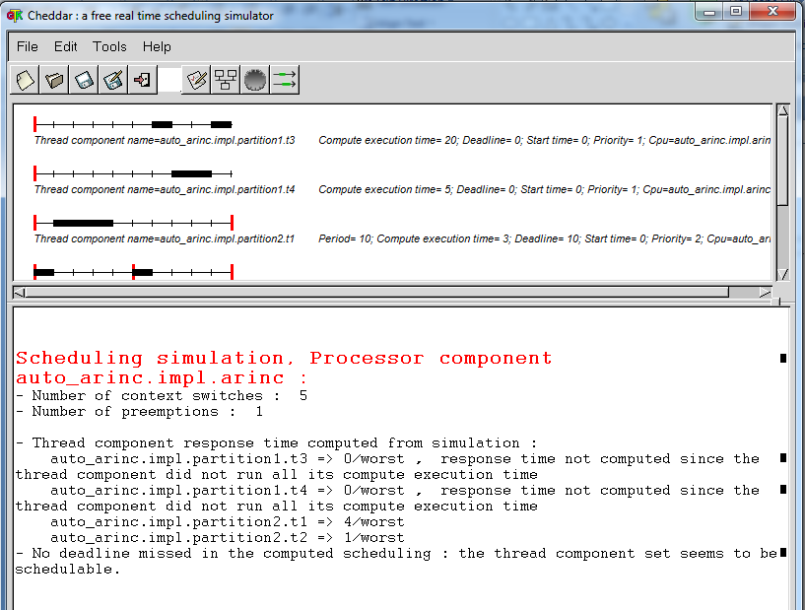
Cheddar

Slide 12
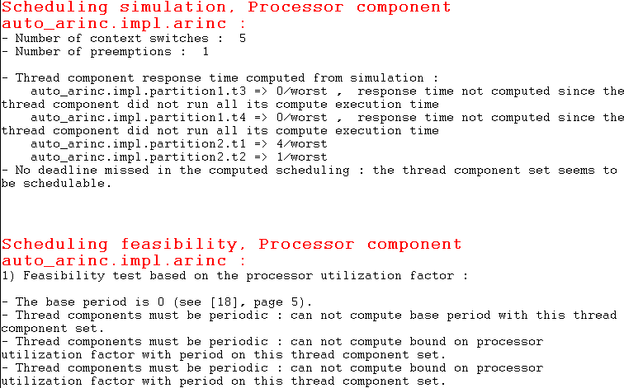
Scheduling feasibility analysis

Slide 13
After you practice on the example do your own:
Build your own scenario
Set the parameters
Use the simulation under Tools

Slide 14
Properties for a thread
For a thread
Dispatch_Protocol => Background;
Compute_Execution_Time => 5 ms .. 5 ms;
Cheddar_Properties::Dispatch_Absolute_Time => 0 ms ;
Cheddar_Properties::POSIX_Scheduling_Policy => SCHED_FIFO;
Cheddar_Properties::Fixed_Priority => 1;

Slide 15
Properties for Processor
Scheduling_Protocol => (AUTOMATA_USER_DEFINED_PROTOCOL);
Cheddar_Properties::Scheduler_Quantum => 0 ms ;
Cheddar_Properties::Preemptive_Scheduler => True;
Cheddar_Properties::Source_Text => ("arinc_processor.sc");
Cheddar_Properties::Automaton_Name => ("processor_scheduler");

Slide 16
For a process
Cheddar_Properties::Scheduling_Protocol => (AUTOMATA_USER_DEFINED_PROTOCOL);
Cheddar_Properties::Scheduler_Quantum => 0 ms ;
Cheddar_Properties::Preemptive_Scheduler => True;
Cheddar_Properties::Source_Text => ("arinc_partition1.sc");
Cheddar_Properties::Automaton_Name => ("partition1_scheduler");

Slide 17
Properties for system
Actual_Processor_Binding => reference arinc applies to partition1;
Actual_Processor_Binding => reference arinc applies to partition2;

Slide 18
Here’s what you are going to do:
Define the Cheddar properties needed for your surgical system
Make reasonable estimates of relative magnitudes of values – document in a read.me
Run scheduling analyses using Cheddar
Submit the AADL, Read.me, and screenshots

